Slide 1

— Amory Lovins
“Energy-saving technologies keep improving faster than they’re applied, so efficiency is an ever larger and cheaper source.”

Slide 2
Energy Efficiency in IoT
- Chandrakant Purbe

Slide 3


Acknowledgement
The British College
University of West of England (UWE)
CCA Department
Department of Cyber Security and Digital Forensics
Faculty Member
Mr. Ujjwal Koirala

Slide 4
Table of Contents
01
02
03
04
Introduction
Major Components of IoT
How Does IoT Work?
Benefits and Challenges
Case Study and Future
05
Conclusion
06

Slide 5
Introduction
IoT
IoT stands for the Internet of Things. It refers to a network of interconnected physical devices, vehicles, buildings, and other objects embedded with sensors, software, and network connectivity. Energy efficiency in IoT is the process of monitoring, control, and conservation of energy across sectors using IoT integration.

Slide 6
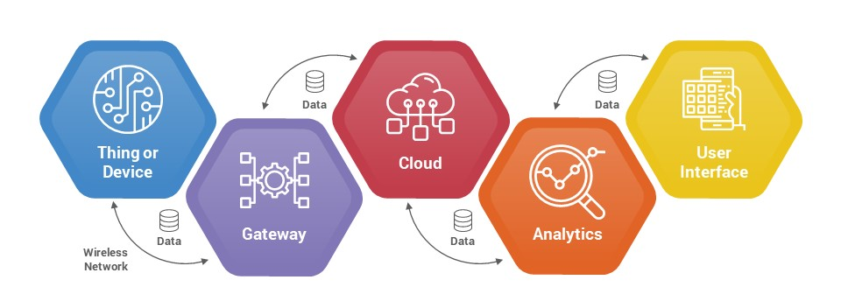
Major Components of IoT Ecosytem

Slide 7
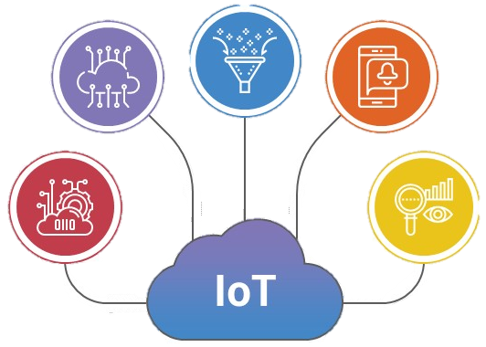
How Does IoT Work?
01
02
03
04
Data Acquisiton
Data Visualization
Data collected by sensors/devices from the environment.
05
It is the process of expressing data or information visually through visual elements like graphs, charts, diagrams, and maps.
Data Transmission
It is the exchange of collected data to the cloud via Gateways.
Data Processing
It is the collection, analysis and interpretation of data transmitted by interconnected devices
Data Analytics
It is the process of examining, cleaning, transforming, and modelling data to extract useful information.

Slide 8
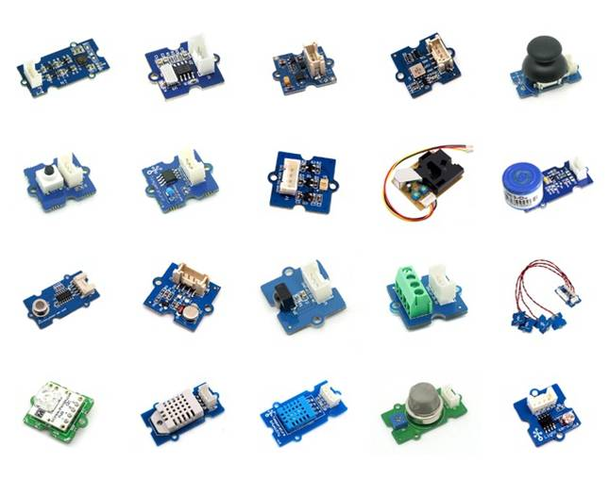
1. Data Acquisition in Energy Efficieny
Motion Sensor
Temperature Sensor
01
02
Motion Sensor is used for occupancy-based relations.
Temperature Sensor is used for HVAC management.
Smart Meter
03
Smart Meter is used to collect real- time energy data.

Slide 9
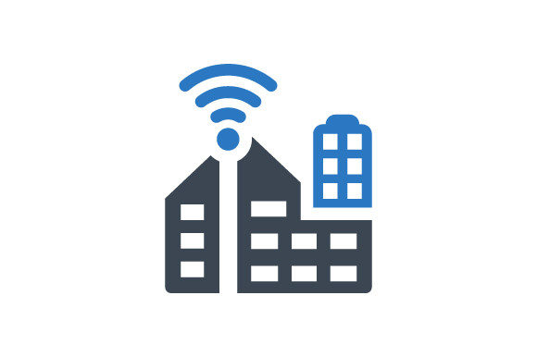
2. Data Transmission
Functions of LoRaWAn
To enable long-range, low-power wireless communication for IoT devices.
LoRaWAN
Why LoRaWAN?
LoRaWAN is a low-power, long-range wireless communication system used to transfer data in applications.
Due to its long-range coverage, low-power operation, and cost-effectiveness, makes it suitable for applications like smart cities, industrial IoT, and environmental monitoring.

Slide 10
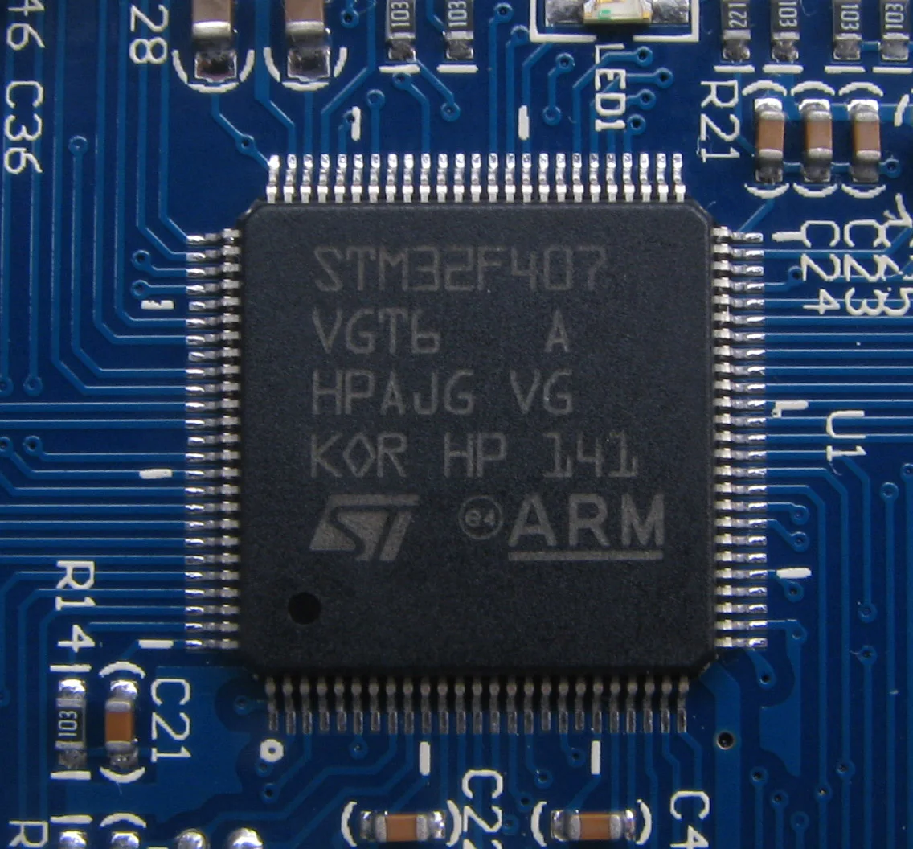
3. Data Processing and Management
Why ARM Cortex-M Sereis?
Due to its customized design, it carefully balances power consumption and effective computation.
ARM Cortex-M Series
Working Mechanism
It comprises microcontroller cores developed by ARM for integrated systems.
It optimizes performance with a fetch-decode-execute cycle, efficient registers, NVIC prioritized interruption handling, and low-power modes, critical for IoT energy conservation.

Slide 11
4. Data Analytics
Identifying and correcting inefficiencies maximizes resource use.
Ensures accuracy and reliability in decision-making.
Day 1
Day 2
Day 3
Day 4
Optimizes energy usage through real-time monitoring and analysis.
Enhancing building automation for energy efficiency.

Slide 12
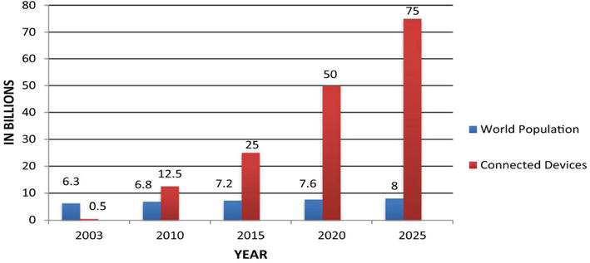
5. Data Visualization
Figure 1 highlights the growing trend of growth on the Internet of Things and highlights its impact on the way devices communicate and exchange information, which can lead to better energy efficiency and management.
Figure 1: Number of Connected devices on the Internet of Things (2003-2025).

Slide 13




Benefits of IoT in Energy Efficiency
Better regualtory compliance
Minimize carbon emission
Reduce operational expenses
Reduce energy spending
Predict consumption and spending
Integrate green energy

Slide 14




Security
Challenges of IoT in Energy Efficiency
Privacy
Complexity
Cost

Slide 15
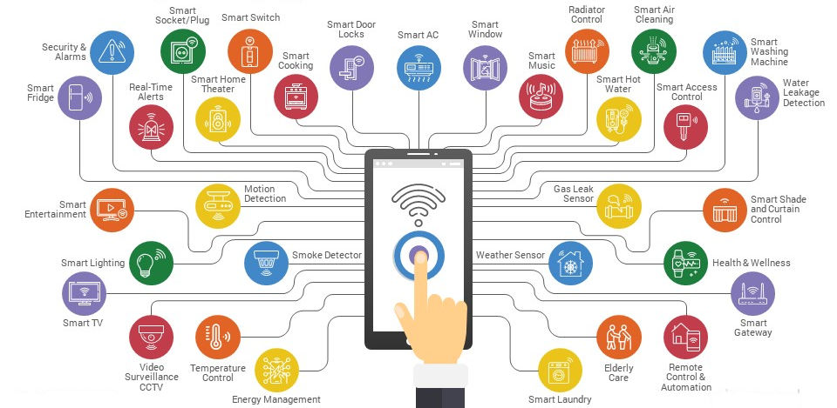
Case Study Example: Smart Home

Slide 16
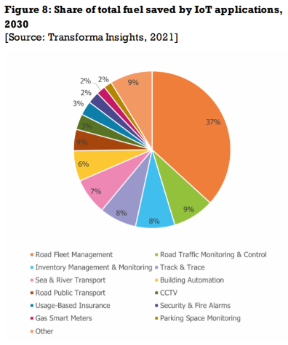
Future Prospects of Energy Efficiency in IoT
A recent report by Transforma Insights and 6GWorld predicts that IoT operations in 2030 will result in remarkable energy efficiency, saving more than eight times the energy they consume.

Slide 17
Conclusion
If you think that the internet has changed your life, think again. The Internet of Things is about to change it all over again!
— Bredan O’Brien

Slide 18
Any Questions?

Slide 19
References
Alenazi, M.M. (2023) IoT and Energy www.intechopen.com [online]. IntechOpen. Available from: https://www.intechopen.com/online-first/88296.
Strathern, F. (2021) IoT Tech Saves 8 Times More Energy | IoT News Internet of Things News. 21 April 2021 [online]. Available from: https://www.iottechnews.com/news/2021/apr/21/iot-technology-will-save-eight-times-the-energy-it-consumes-by-2030-new-report-shows/.
‘6 Great Advantages of Transforming the Energy Sector with IoT’ (no date) Biz4Intellia [online]. Available from: https://www.biz4intellia.com/blog/6-great-advantages-of-transforming-the-energy-sector-with-iot/#:~:text=IoT%20provides%20a%20smart%20grid.
‌
‌
‌

Slide 20
Thank You!

